Slide 1


Dependency Injection
Program to an Interface, not an Implementation
High Cohesion, Low Coupling

Slide 2
Definition
Dependency Injection is a set of software design principles and patterns that enable us to develop loosely coupled code.
When you go and get things out of the refrigerator for yourself, you can cause problems. You might leave the door open, you might get something Mommy or Daddy doesn’t want you to have. You might even be looking for something we don’t even have or which has expired.
What you should be doing is stating a need, “I need something to drink with lunch,” and then we will make sure you have something when you sit down to eat.

Slide 3
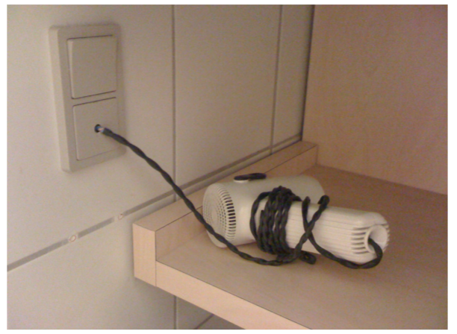
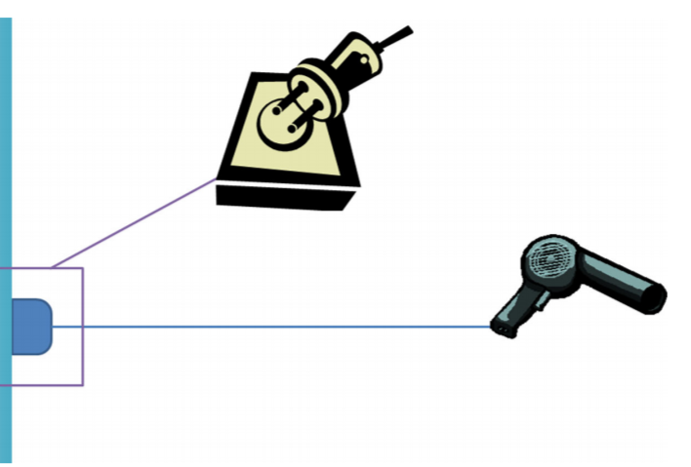
Decoupling
A hardwired hairdryer is tightly coupled and requires extra work to replace either the electrical wiring, or the hairdryer in the future.
A socket decouples the electrical system from the hairdryer.

Slide 4
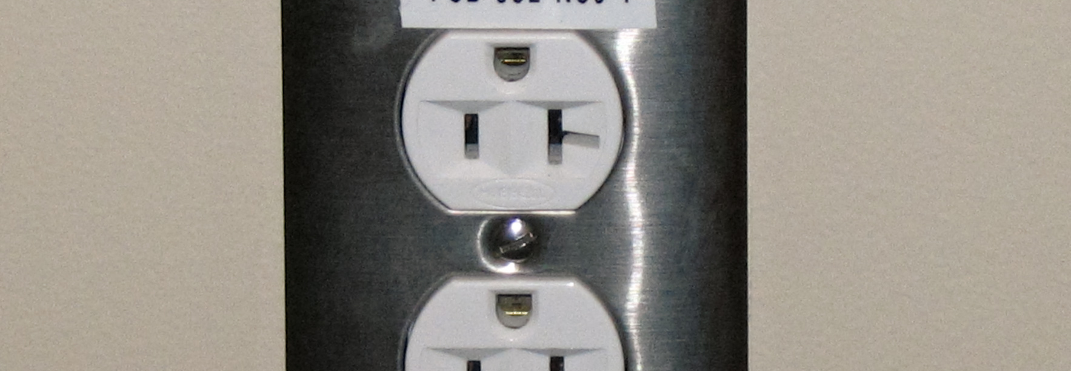
Electrical Socket Interface
Socket Shape
Socket Count
Voltage
Max Amperage

Slide 5
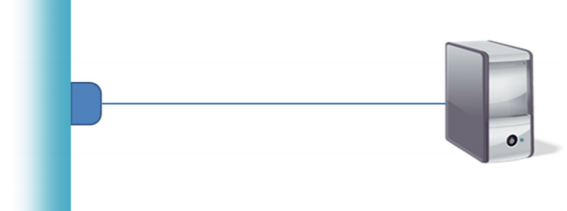
Liskov Substitution Principle
We can plug something else into the wall socket – not just a hairdryer.
However, the appliance must conform to the interface.
Can’t draw excessive amperage, must have the same physical connector.

Slide 6
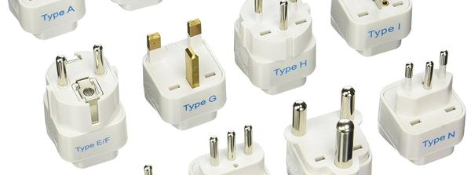
Adapter Pattern
An adapter allows us to resolve (some) discrepancies between interfaces.
However, we cannot violate the underlying interface requirements.
Not safe to use an adapter to convert a 120V/15A socket to 250V/50A.

Slide 7
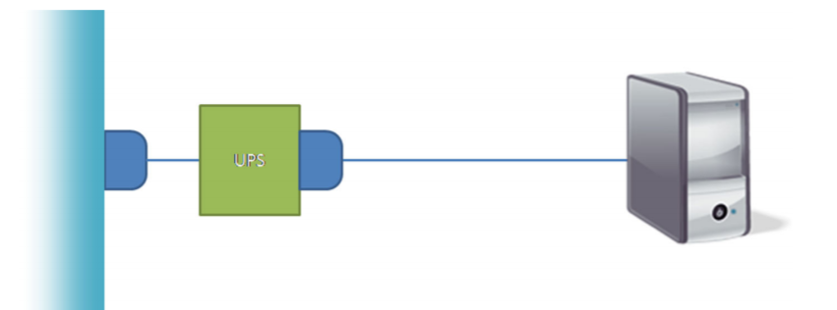
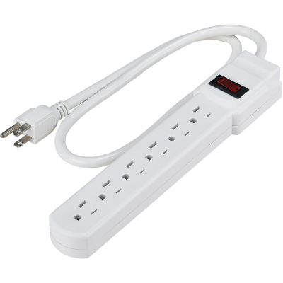
Decorator Pattern / Composite Pattern
We can alter functionality without changing either socket or appliance.

Slide 8
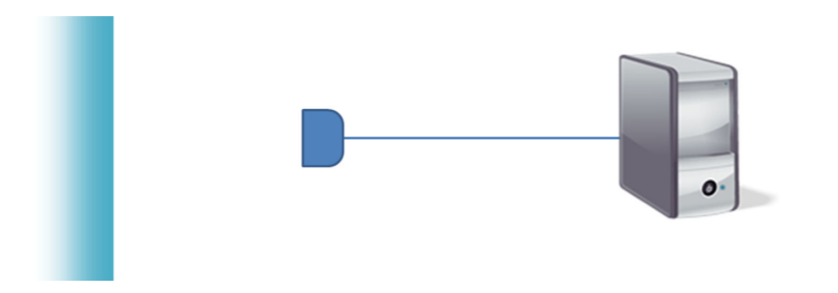
Null Object Pattern
We can disconnect components entirely, without affecting the other.
That said, we still need to conform to the interface.

